Slide 1


Viksit Bharat Young Leaders Dialogue, 2025
Empowering Women and Improving Social Indicators
Theme/track of the topic:
Gender Equality, Women safety, Education, Feminism and Patriarchy, Gender Sensitisation and Sex Education, Economic Independence of Women and Confidence Building.
Name:
AUROSEE PANDA
PARTHA SARATHI BEHURIA
ANKITA GANGULI

Slide 2

Viksit Bharat Young Leaders Dialogue, 2025
UNDERSTANDING OF THE TOPIC
Empowerment of women is a fundamental step towards a progressive society which is one of the goals of the Viksit Bharat 2047.

Slide 3
Viksit Bharat Young Leaders Dialogue, 2025
BARRIERS TO WOMEN EMPOWERMENT
Lack of access to education
Cultural norms
Safety concerns
Lack of confidence and self belief
Economic Inequality
Digital Divide
Media Portrayal

Slide 4





Viksit Bharat Young Leaders Dialogue, 2025
THE CURRENT STATUS
Starting off with government’s efforts:
BETI BACHAO BETI PADHAO
PRADHAN MANTRI MATRU VANDANA YOJANA
MAHILA SHAKTI KENDRA
MUSLIM WOMEN {PROTECTION OF RIGHTS ON MARRAIGE} ACT 2019
PRADHAN MANTRI JAN DHAN YOJANA

Slide 5
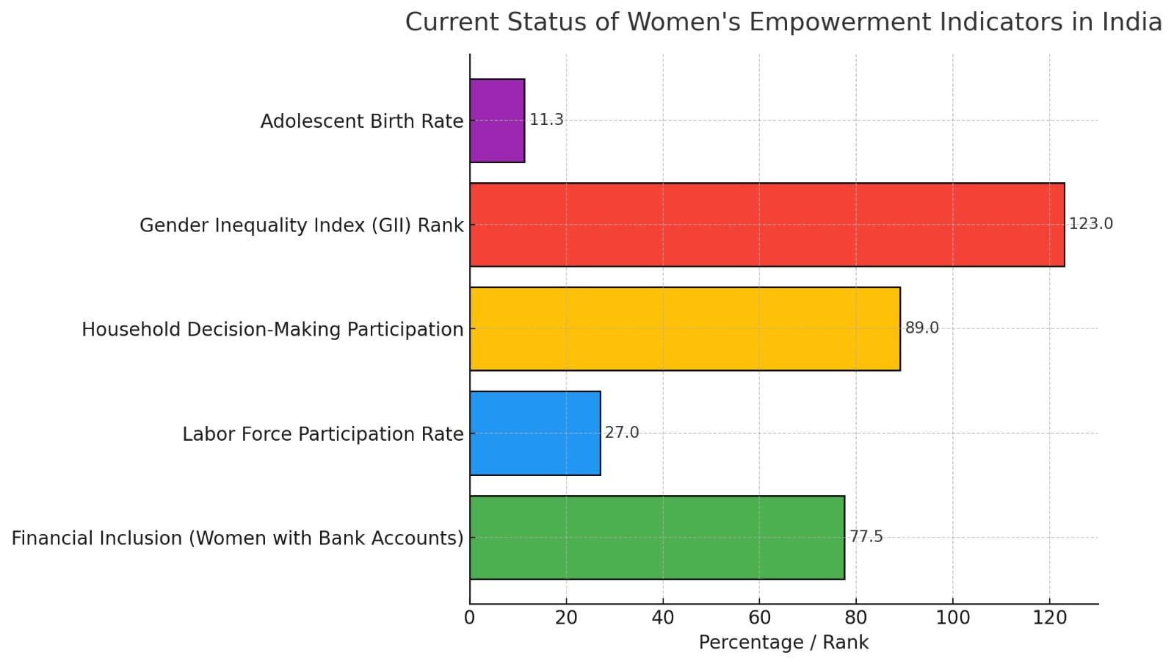
Viksit Bharat Young Leaders Dialogue, 2025

Slide 6

Viksit Bharat Young Leaders Dialogue, 2025
AREAS THAT NEED IMMEDIATE ACTION
Socio-economic inequality
Gender inequality
Geographic Disparities
Gender Pay Gap
Stigma around women in leadership and STEM
Workplace harassment
Rape/sexual harassment
Domestic Violence
Women Trafficking
Stalking
Lack of legal protection
Lack of awareness on:
Feminism
Sexual and reproductive health education
Mental health
Cultural norms
Legal, financial, digital literacy
Safety
Education
Access to Equal Opportunities

Slide 7

Viksit Bharat Young Leaders Dialogue, 2025
SOLUTIONS TO IMPROVE THE SOCIAL AREAS OF FOCUS
A predictive model that identifies safety risks for women in urban and rural areas. It includes:
- Authentic data collection by law
- Data processing
- Increased CCTVs in society for the app to provide real time footage
- Provision of Colour coded maps showing risk levels
- Live alerts
- Recommends safer routes
STRICT LAWS, QUICKER JUSTICE, STRONGER PUNISHMENT

Slide 8

Viksit Bharat Young Leaders Dialogue, 2025
SOLUTIONS TO IMPROVE THE SOCIAL AREAS OF FOCUS
- Compulsory Sex Education
- Well Built Schools for Easy Access to Education
- Well Educated and Well Qualified teachers
- Legal, Financial, Digital Literacy
- Students should be taught about Gender Equality, Feminism, Cultural Norms etc on a compulsory basis

Slide 9
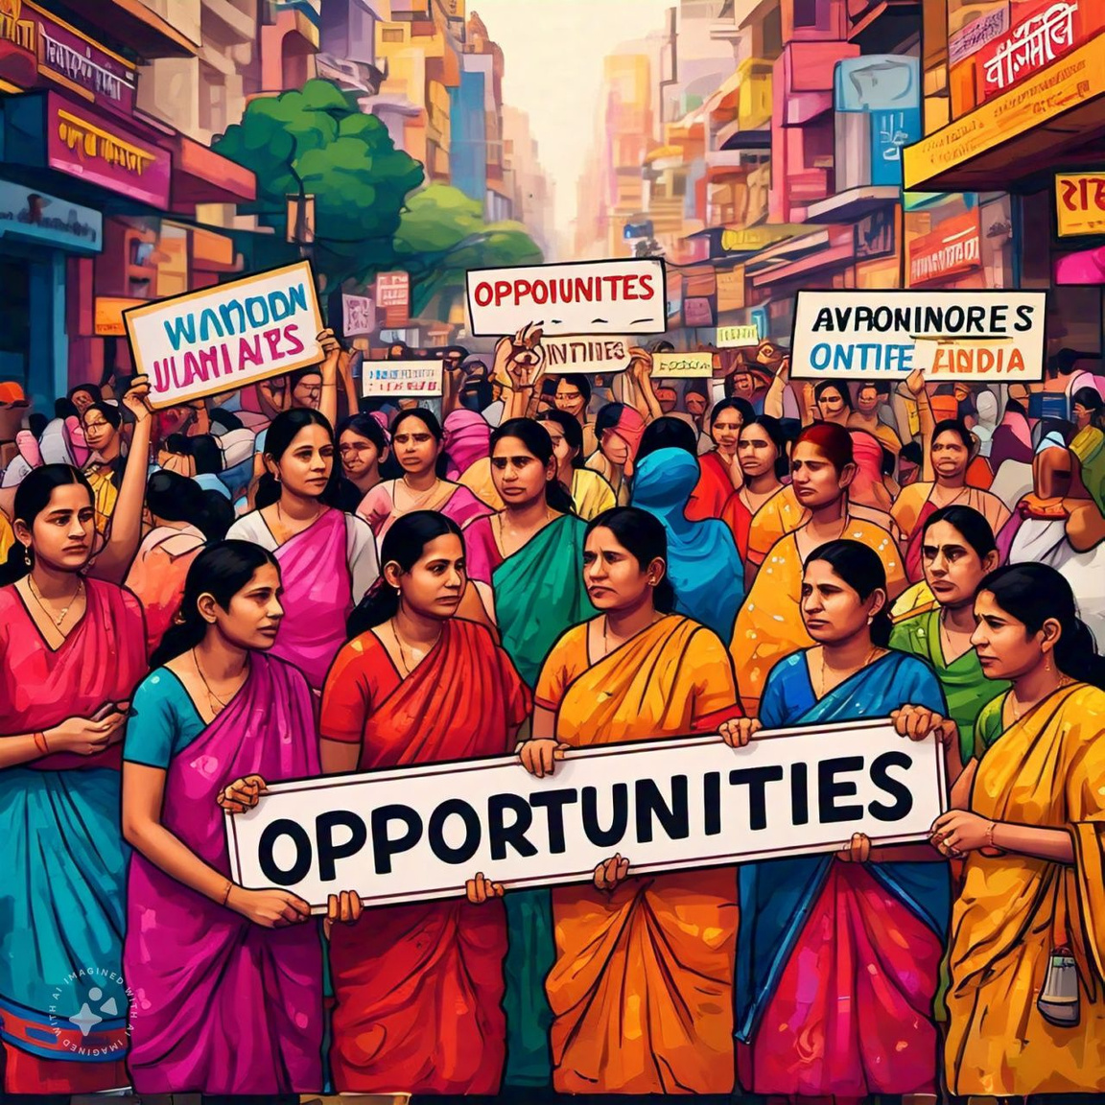
Viksit Bharat Young Leaders Dialogue, 2025
SOLUTIONS TO IMPROVE THE SOCIAL AREAS OF FOCUS
Mentorship by creating a helpline or an app that allows women and their families to approach experts
Create college student internships
Create women leadership circles {WLCs} by the department of women and child development in India
Adding to which there will be more women in stem and businesses

Slide 10
Viksit Bharat Young Leaders Dialogue, 2025
IMPACT OF THESE SOLUTIONS IN THE NATION
Enhanced Safety and Freedom
Cultural Transformation
Improved Global Standing
Sustainable Development
Generational Change

Slide 11

Viksit Bharat Young Leaders Dialogue, 2025
CONCLUSION
EMPOWERED WOMEN = BETTER SOCIAL INDICATORS

Slide 12



Viksit Bharat Young Leaders Dialogue, 2025
Thank you!

